Slide 1
Conversational Assessment Platform Overview
Conversational Assessment Platform
Virender Aggarwal
Founder, ConvInt
ConvInt.ai is a conversational intelligence platform helping you run your business with internal and external stakeholders through chat. It is intelligent, contextual and keeps improving as the conversations grow.
1

Slide 2
Problem Statement
The ConvInt.ai Hiring 2.0 way
Recruiters are expected to have the technical expertise in every subject. This is an undue challenge as most recruiters' expertise is in personality-based screening.
1
No resumes. Need only name and email id.
1
2
No scheduling required. Assessment can be triggered to 1000s simultaneously
Recruitment Manager
One of a company’s most valuable resources – the hiring manager – is consumed scheduling and technical screening numerous resumes.
2
3
No App. No Portal. Just a conversation
Overall hiring time is excruciating long and very unpredictable. Resulting in managers inability to complete their projects on schedule.
4
Creator economy where everyone contributes and gains
3
Hiring Manager
Instead of following “If it ain’t broke don’t fix it” we believe if the process is a pain and wasting your time and money then go ahead and break it!
We live by KISS. Remove the “MUDA” (waste) from the process. There is nothing wrong with making your job/life more simple. Especially when it makes you more productive at the same time!
2
3

Slide 3
Going Resume-less
The ConvInt.ai Hiring 2.0 way
Candidate
Assessment
Report
(CAR)
Enable recruitment team with technical assessment tools
Enable recruiters to speak same language as hiring manager
Enable recruitment team to assess candidates objectively without bias
Email id
Apply Now
1
Name
Apply Now can go on the Careers Page or LinkedIn Job Posting
Just the Email and Name are captured
An invite is sent to the Candidate automatically to take the screening assessment
The assessment report of shortlisted candidates is sent to the Recruiter for the next steps
Recruitment Team
Conversational Intelligence Assessment Platform
Hiring Manager
Enables hiring at scale; 1000’s of simultaneous screenings
Reduces recruitment cycle time significantly
Focus is on team/culture fit
2
When we no longer used horse and buggy to get around we no longer needed the buggy whip. Well, unless you think reading fake resumes is fun then can we agree it is time to get rid of those resumes!
Tools enable humans to do so much more than. Our technology does just that. It enables you top more with less – less time and less aggravation. You get more time back in your day to focus on what’s really important.
4
5

Slide 4
Convint.ai Solution -
How it delivers results
Automated technical assessments through Convint.ai platform
Get started in 3 simple steps
Automated technical assessments through Convint.ai platform
Makes hiring manager massively efficient
Select candidates based on objective scores
Enables hiring manager to achieve business goals
3
Share Intro
Video or
any MUST
ASK Questions
Analytics and Client Assessment Report (CAR)
Define Roles
& map Skills against them
Share list of
Candidates
Candidate
Assessment
Report
Step 1
One time configuration
Step 2
One time configuration
Step 3
Anytime new candidate
need assessment
Hiring Manager
Candidate profile summary becomes much smarter
Top candidates get off the market fast
Summary and detail candidate assessment for further review
4
Your HR people and external recruiters work hard to get the best candidates in front of you. But often you still need to do another round of technical assessments by reading those same resumes. Not anymore! You will love the quality of the candidates you get from this new process.
Not only do we remove the “MUDA” (waste) from the process, but what remains is so easy it may not even feel like work! Everything we do is 1-2-3 voilà!
6
7

Slide 5
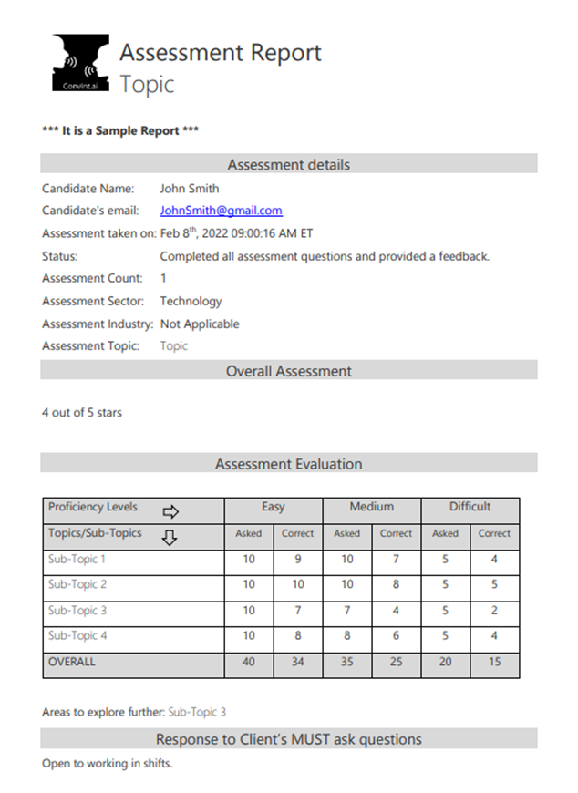
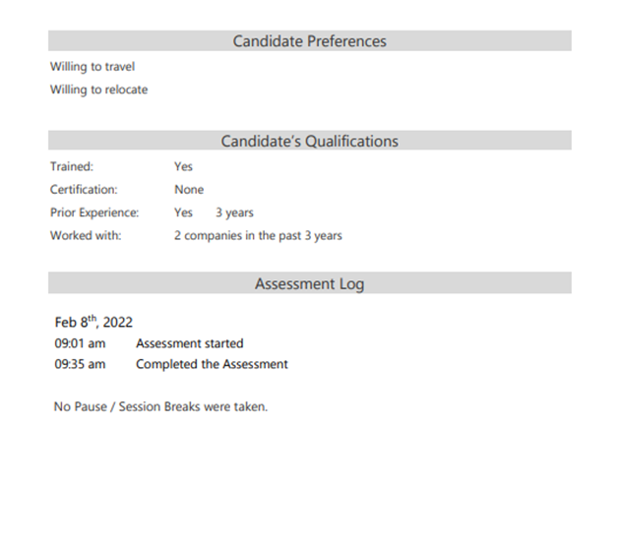
Convint.ai Solution - Summary in metrics
Receive Candidate Assessment Report (CAR)
50% reduction in recruiter’s workload
80% reduction in hiring manager’s time
50% increase in overall hiring efficiency
Every time a candidate completes the assessment a CAR is shared
Assessment Details
Overall Assessment
Per topic assessment
Response to MUST ASK Qs
Candidate Preferences
Candidate Qualifications
Assessment Log
Assessment also available on request
Recruitment Team
Hiring Manager
Recruitment Process
Automates scheduling and screenings
Makes best candidates visible from screened list
Provides view into detailed candidate screening for further assurance
Receives fully qualified candidates compared to numerous resumes
Hiring manager has more time to behaviorally screen candidates
Easy onboarding
80% faster hiring
Lowers cost by 60%
Larger talent pool
50% higher talent
50% faster onboarding
Most people love to see the metrics – what has it do for me? So here’s a few we have averaged from what our customers share with us. Will you get the same results? Who knows, but if they are better or slightly less they will in any case be better than what you are getting today.
All you do is sit back and watch the Candidate Assessment Reports come to you. You receive both a summary of all candidates (as of this minute) and all the details of how they were ranked against others. It’s almost magic!
8
9

Slide 6
List of technology screenings available today
Are you ready to leverage convint.ai to drive efficiencies in your hiring process?
screenings available CLOUD | LANGUAGES | SALESFORCE-DEVELOPMENT | DATABASE
AWS | .net | Admin | Hadoop
GCP | AngularJS | App Dev and Deployment Designer | MongoDB
Kubernetes | Flutter | Data Arch & Mgmt. | NoSQL
MS-Azure | GO | Developer | PostgreSQL
 | HTML/CSS | Einstein | RDBMS
SALESFORCE-CLOUD | Java | Integration | SQL Server
Commerce Cloud | JavaScript | Javascript
Community Cloud | Kotlin | Lightning Aura | OTHER
CPQ | NodeJS | LWC | Adobe
Experience Cloud | PL/SQL |  | Agile
Marketing Cloud | Python | SaaS | Android
SAC Cloud | ReactJS | MS Power Platform | Cybersecurity
Sales Cloud | RubyonRails | Salesforce | Django
Service Cloud | Scala | SuccessFactors | Git
Vlocity | Swift | UiPath | Google Ads
 | T-SQL |  | Java Spring
 |  |  | ML/AI
 |  |  | MS-Power
 |  |  | REST-API
Tim Montgomery
+1 518-480-7164
And the list keeps growing. And we have non-technology areas including Home Care, Cannabis, Accounting, et al.
Schedule a Demo: https://calendly.com/tim_montgomery/ai-based-candidate-screening-demo
We keep adding to the list of skills we use to assess candidates. And our customers help us expand by letting us know what skills they would like added. Do you have some you’d like to ask us to include?
In line with keeping it simple, we show you how simple our technology is to use. Then we follow a Crawl, Walk, Run approach by letting you pilot the technology, then use it for a while and let us know what type of “package” or pricing works best for you. Let’s talk!
10
11

